Slide 1

An Intro to Scientific Machine Learning Data-driven modeling, digital twins, and physics-informed machine intelligence
Nat Trask
Center for Computing Research
Sandia National Laboratories
University of Pennsylvania (starting 9/1)
SAND2022-13046 C

Slide 2
Scientific Machine Learning (SciML) Integration of scientific computing with machine learning
Talk overview
An introduction to data-driven modeling
EX
Shock physics in pulsed power fusion
ML for digital twins of complex systems
EX
Multiscale design in semiconductor physics
ML for discovery science
EX
Optimal material design and manufacturing

Slide 3
Intro to data-driven modeling Some data-driven modeling (DDM) exemplar problems

Slide 4
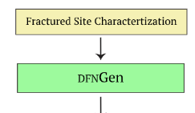
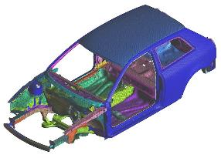
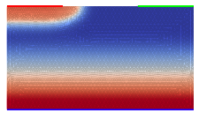

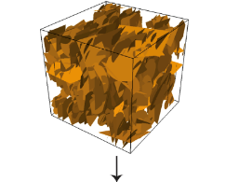
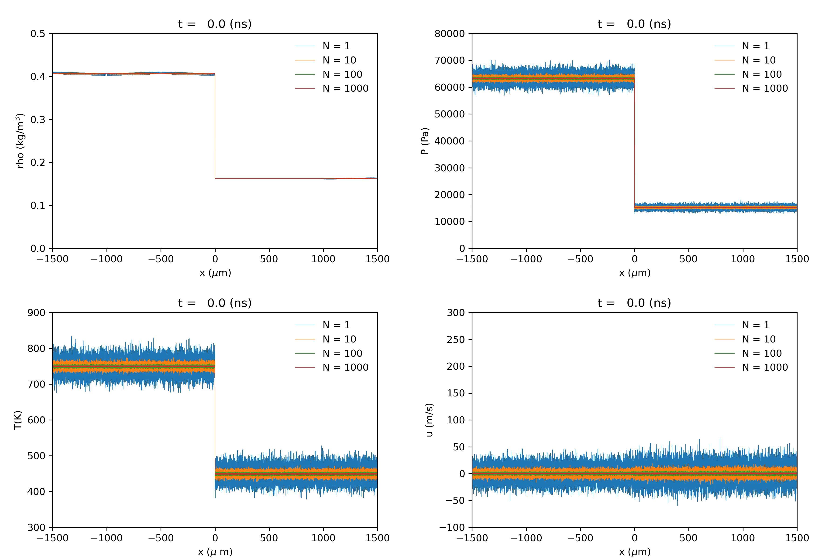
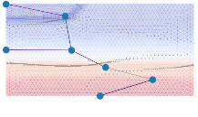
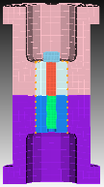
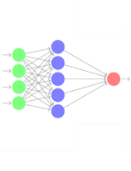
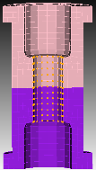
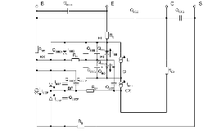
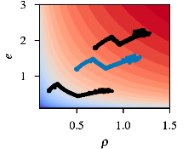
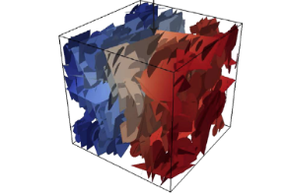
Data-driven modeling for high-consequence engineering
Speed
Correct PFLOTRAN Solution
Data-driven compact models
Data-driven shock magnetohydrodynamics
Data-driven subsurface fracture
Data-driven solid mechanics
Classical Sim
First-principles
Data-driven modeling
ML physics

Slide 5
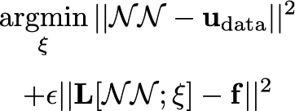
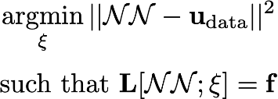
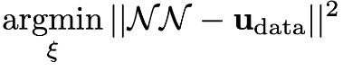
Moving beyond “physics-informed ML”
”Black-box” ML
No physics + big data
Physics-informed ML
Weak physics alleviate data requirements
Structure preserving ML
Exact physics treatment independent of data
No domain expertise Strong physical priors
What guarantees are needed to deploy ML in high consequence engineering settings?
How to enforce physics when explicit model form is unknown?
How to train networks effectively to obtain both a good fit to data and enforce physics exactly?
How to guarantee convergence, stability, and physical realizability?

Slide 6
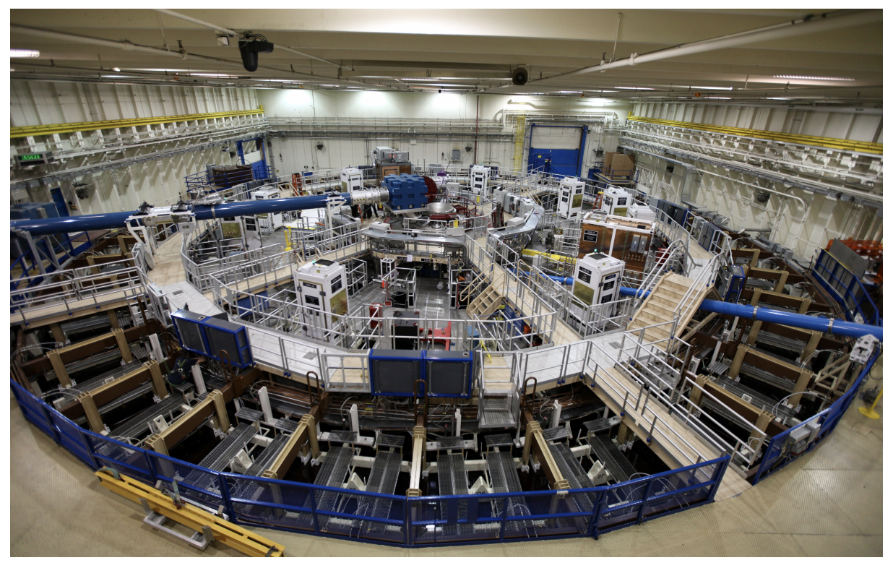
Ex: Shock magnetohydro experiments on Z-machine

Slide 7
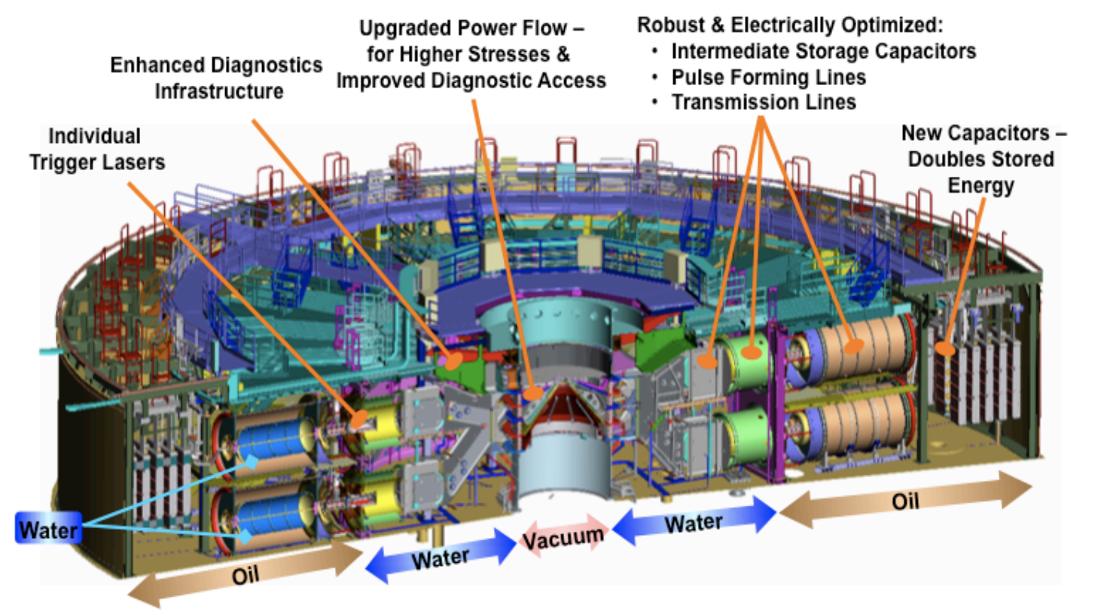
Ex: Shock magnetohydro experiments on Z-machine

Slide 8


Ex: Shock magnetohydro experiments on Z-machine
Flyer plate
Material under test
Discovery of material EOS:
How to extract EOS under extreme conditions from shock response?
DDM to augment and accelerate intensive model calibration
No direct measurements of EOS are available!
Initial time
Magnetic field from Z pushes flier
Mid time
Impact drives shock to study response
Final time
Synthetic data: MD simulations of shocked material
Credits: ASC, Philms project funding

Slide 9
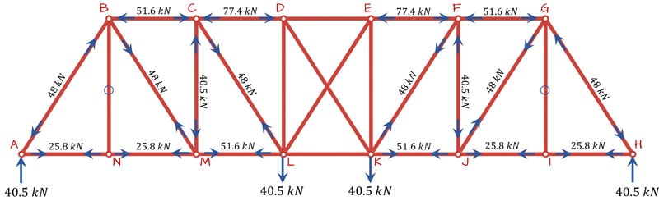
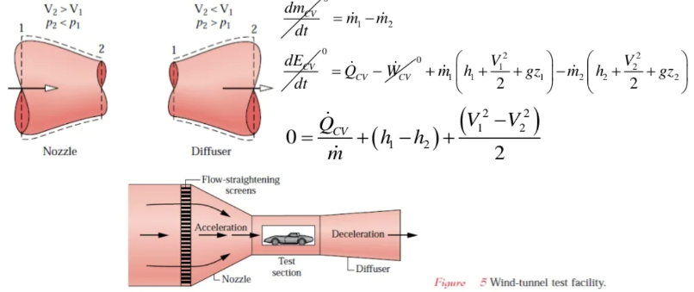
Can ML emulate engineering judgement?
Toward Physics-Informed Machine Intelligence
Using ML to emulate reasoning tasks that currently humans can only do

Slide 10
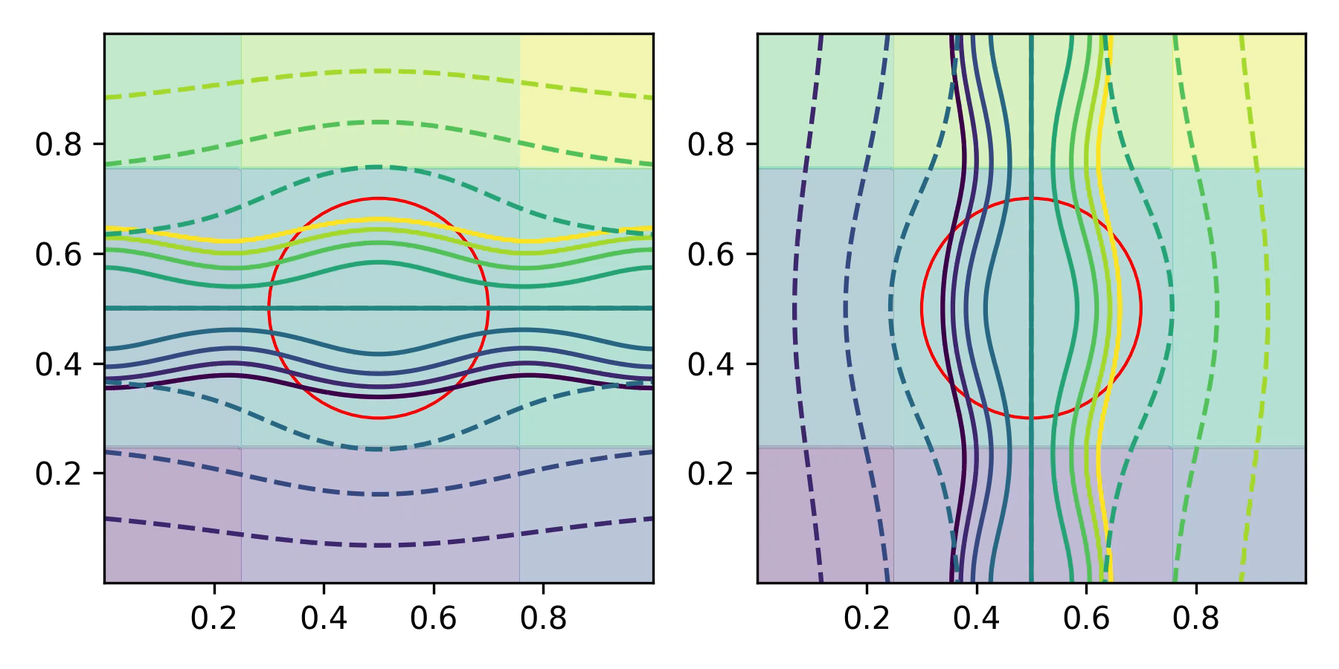
High-level picture of how data-driven finite elements work
BC + solution
Mimetic FEM
Production code
Training
Embedding
Obtain a finite element with geometry+physics embedded in terms of local conservation balances, bridging geometric and graph perspectives

Slide 11
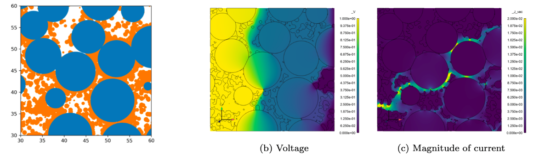

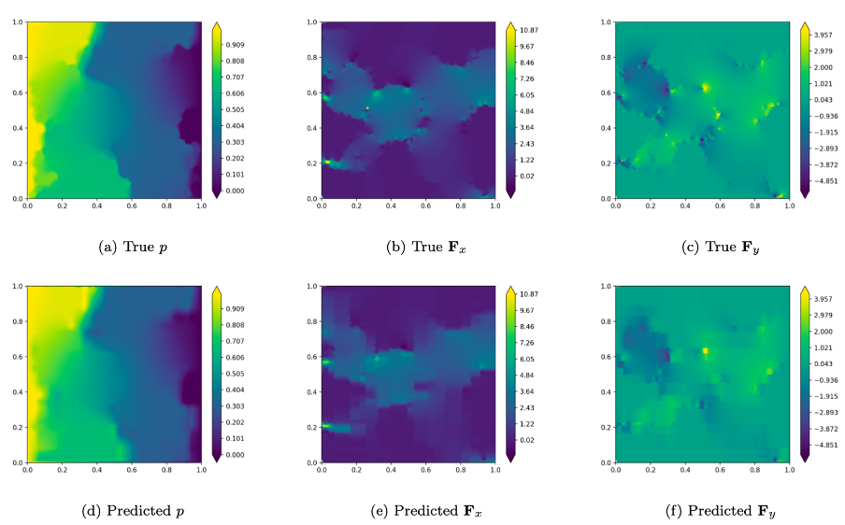
Digital twin of as-built lithium-ion battery microstructure
Replace a 5.89M finite element simulation of as-built geometry with 8 data-driven elements w/ ~0.1% error
implemented in production FEM code

Slide 12
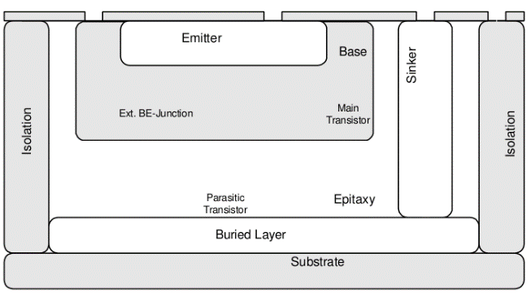
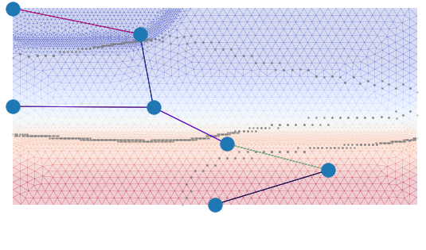
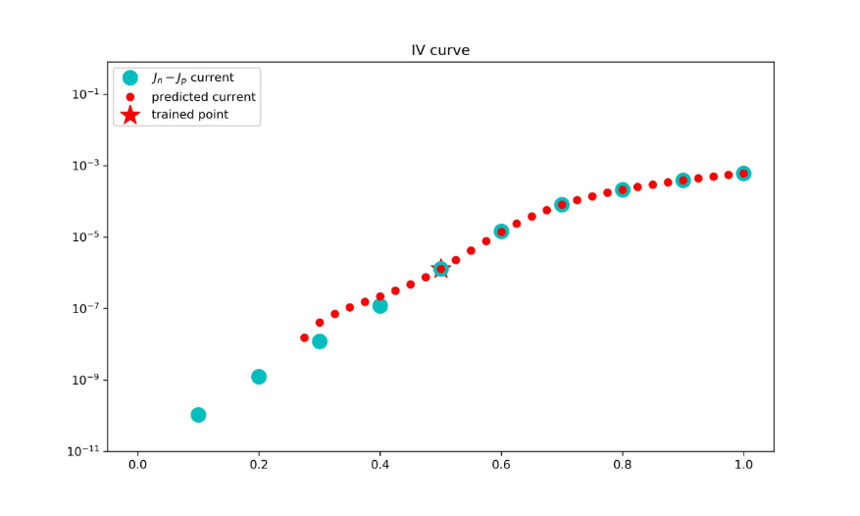
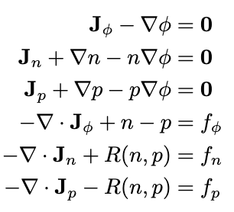
Reduced semiconductor models from a single datapoint

Slide 13
Intro to complex systems Assembling data-driven building blocks to consider complex systems

Slide 14
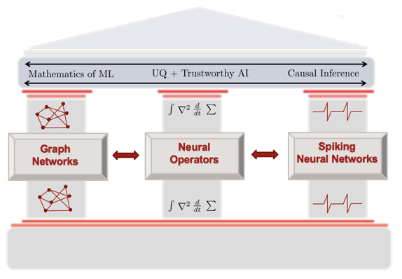
Scalable Efficient and Accurate Causal Reasoning with Operators, Graphs, and Spikes Director: George Karniadakis (PNNL/Brown) Deputy Director: Nat Trask (SNL)
Objective
Mathematics of next-generation ML architectures to support digital twins of complex systems
Focus
Performance – 1000x faster solvers
Efficiency – 10x lower power
Hardware/software codesign
Workforce development
4 SNL staff, 3 postdocs
Pipeline from 6 universities

Slide 15
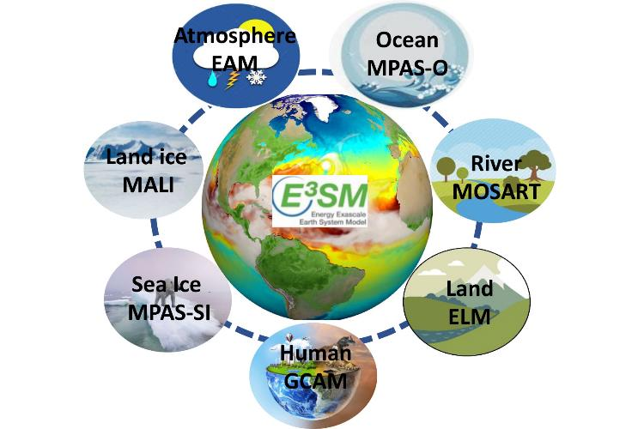
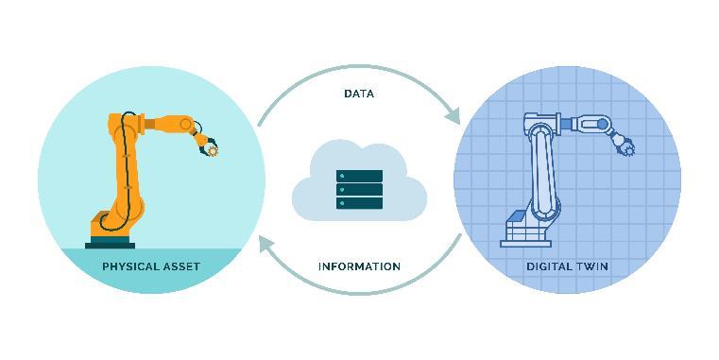
Causal digital twins for systems-of-systems
“The size and complexity of many systems being built for government, industry, and the military have reached a threshold where customary methods of analysis, design, implementation, and operation are no longer suﬀiciently reliable. Many of these large systems are properly described as “systems-of-systems” in that they are composed of many systems” (Dvorak 2005)
Mathematical Requirements
Massive acceleration
Stable coupling
Efficient data assimilation
Physical structure preservation
Causal structure preservation
Support VV+UQ
Multimodal/multiscale data

Slide 16
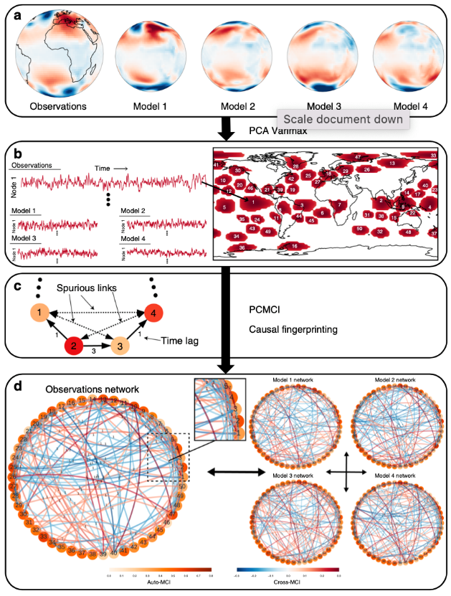

Causal digital twins for systems-of-systems
Can we develop causal deep learning architectures to detect precursors to extreme weather?
Can we develop power-efficient algorithms/hardware to detect these warning signals from sensor networks?
Nowack, P., Runge, J., Eyring, V. et al. Causal networks for climate model evaluation and constrained projections. Nat Commun 11, 1415 (2020). https://doi.org/10.1038/s41467-020-15195-y

Slide 17

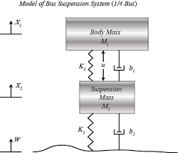
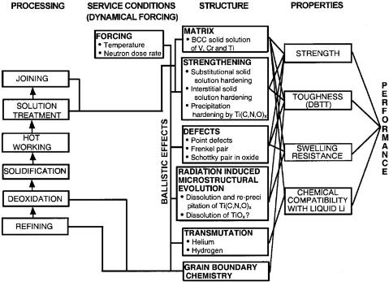
Systems-of-systems are ubiquitous in NNSA/DOE complex
Mechanical assemblies
Multiphysics across coupled components
Chemical/material synthesis
Bridging scales across process/structure/property
Fusion Power
Plasma/material interactions
Graphs naturally describe relationships between constituent legacy codes

Slide 18
Intro to complex systems Microelectronics ”codesign” as an exemplar problem

Slide 19
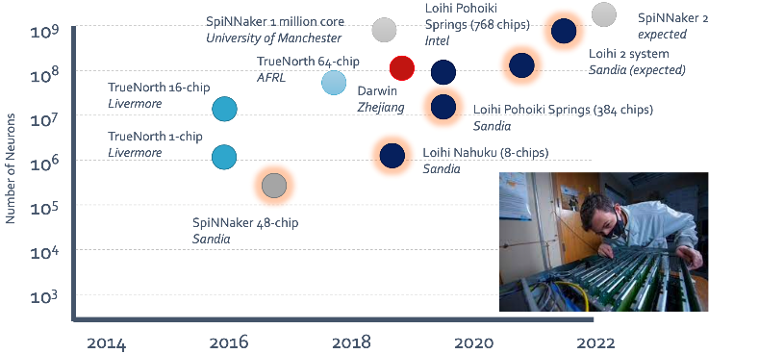
Why do we need math/hardware codesign
Extreme Cost of ML
GPT-3 required 4.6 exaFLOPS to train!
Unique DOE challenges
Unlike industrial “foundation models” trained on monolithic datasets, we have many datasets with varying sensitivity
Next-generation hardware
Neuromorphic/FPGA provides orders of magnitude power reduction
SNL has unique strengths developing math/algorithms to run on novel hardware!
Thompson, N.C., Greenewald, K., Lee, K. and Manso, G.F., 2020. The computational limits of deep learning.
According to OpenAI, the training of GPT-3 used approximately 4.6 exaFLOPS of compute, equivalent to about 53,000 NVIDIA A100 GPUs running for about 4 days!

Slide 20
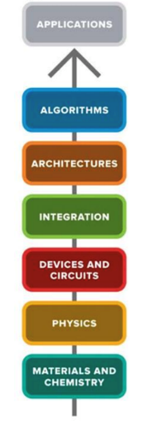
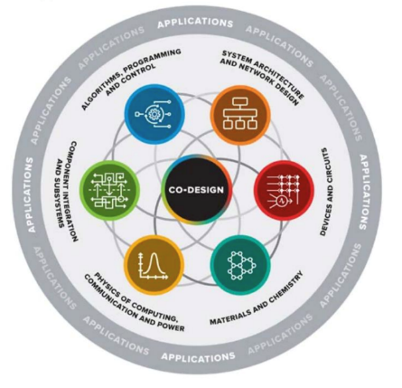

Need co-design to traverse microelectronics hierarchy
Quantum Continuum
System
Increasing length scale
Decreasing model cost
Device 1
Device 2
Component 1
Component 2
Material 1
Material 2
Traditional design:
Big production codes
Siloed expertise
Toss results over the fence
Microelectronics
Small footprint
means coupled physics
across scales
Co-design:
How can we simultaneously optimize all components in hierarchy?

Slide 21
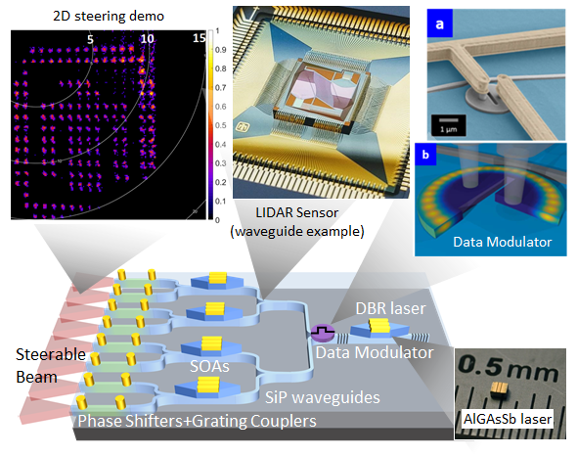
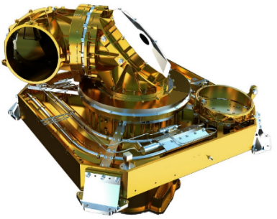
Concretely: Shrinking the footprint of an optical comm
Laser Communication Terminal (LCT)
Bandwidth: 1.8 Gbps
Range: 45,000 km
Mass: 56kg
TX power: 2.2 W
Telescope diameter: 13.5 cm
Payload power: 185 W
Wavelength: 1550 nm
Envelope: 0.6 x 0.6 x 0.7 m³
Big device O(1m³)
Individual systems
Large motor to point and steer laser
Small device O(1cm³)
Integrated multiphysics
No mechanical system
Challenge: cross device coupling
Notes:
Optimal comms are promising remote sensing systems need high-bandwidth, secure communications
Optical comms are promising due to their high-bandwidth capability and directional beams…However, current optical comms are large, heavy, and power hungry due to their use of bulk components to adapt terrestrial optical comms technology
Therefore, we are developing chip-scale, high output power, semiconductor laser transmitters
Silicon photonics backbone → routing, coupling, optical phased arrays
III-V optical sources → extensive growth and processing expertise
Heterogeneous integration → MESA core competency

Slide 22
What physics do we need to treat at a device level?
Flow of device
Voltage drop/current source provides power to laser
Recombination in laser diode generate photons
Photons combine into optical wavelength E&M
Data modulator shapes light to encode data
Silicon photonics waveguide splits signal to obtain multiple identical channels
Optical OpAmps boost power of split signals back up to original level
Phase shifters use voltage-induced temperature differential to modulate permittivity
Modulated permittivity is used to control constructive/destructive interference in laser phase array and achieve a directed light source
Due to tight layout, all physics are coupled!

Slide 23
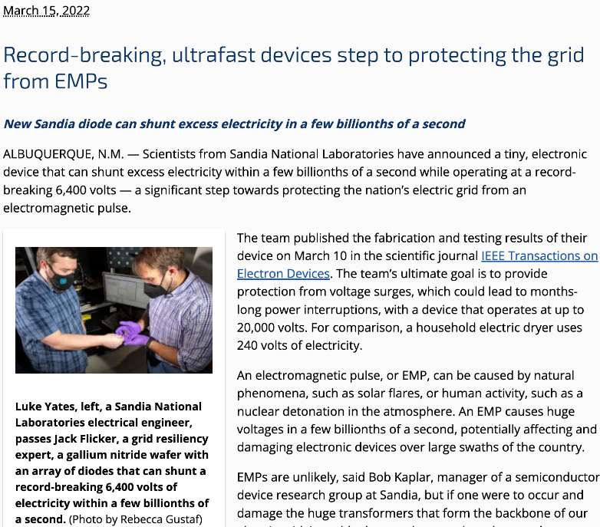
Where does traditional one-way design break down?
System
Minimal modeling
between devices
Device
Decade to develop CM
Component
1M+ elements per component
Material
Huge DFT/MD campaigns
Established modeling for e.g. CMOS breaks down for novel materials
With 1 fabrication per year – need better predictive models!

Slide 24
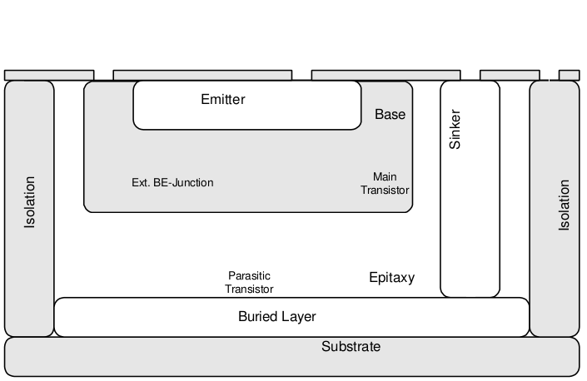
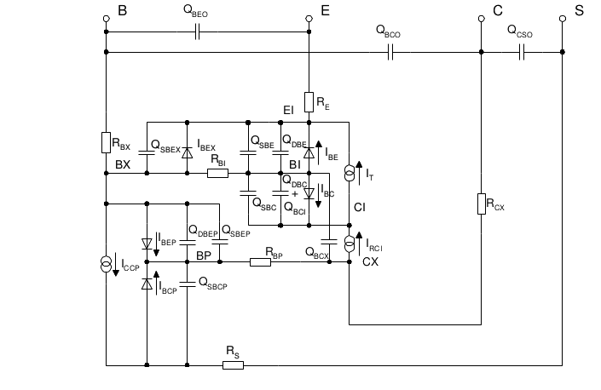



Rapid radiation-hardened semiconductor design
Decade to develop empirical circuit models for a given semiconductor device!
Generalizing to new materials requires
O(1 month) turnaround vs years
DDM idea: Use high-fidelity drift-diffusion simulations to train a cheap circuit model, while guaranteeing stability + accuracy
time
Gaussian dose rate pulse in semiconductor,
peak at 200 ns
Top: PDE simulation of BJT device
Bottom: Empirical compact/circuit model
Left: Modeling challenge: impact of radiation on nominal device behavior
Credits: PIRAMID LDRD, accepted for publication in IEEE SISPAD

Slide 25
Intro to ML for scientific discovery Causal learning and material science

Slide 26
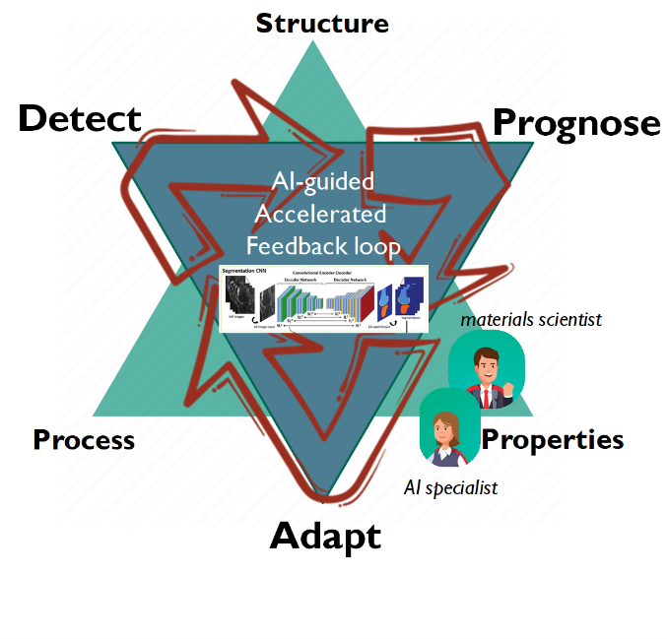
Bridging the Process-Structure-Property gap with ML
Traditional material science:
Small numbers of experiments tailored toward simple/tractable models
Hypothesis: SciML can help, but exploit multimodality to overcome small data

Slide 27
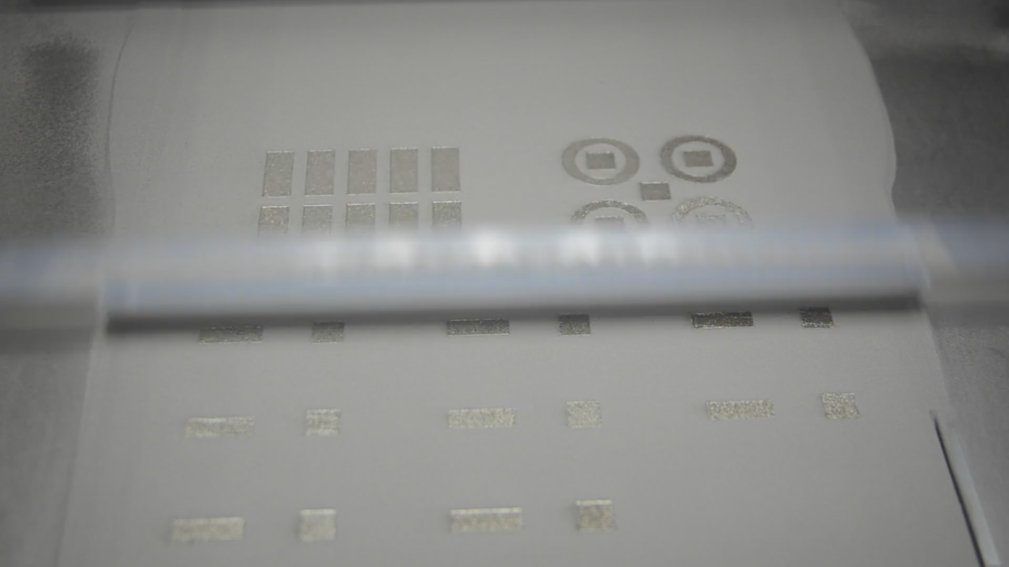
Multimodality in advanced manufacturing processes Multimodality: heterogeneous data Process parameters: laser, powder, speed High-fidelity characterization: microscopy, XRF, XRD, TEM, SEM Low-fidelity signals: light, sound, images, profilometry

Slide 28
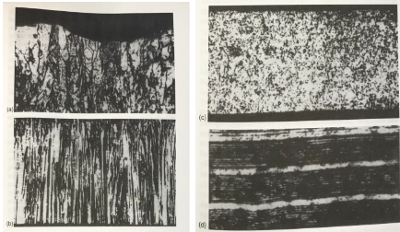
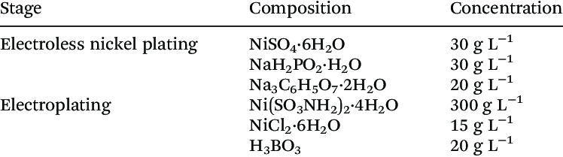
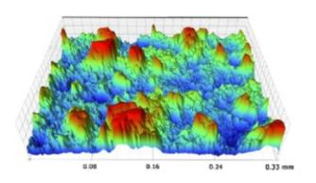
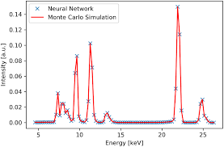
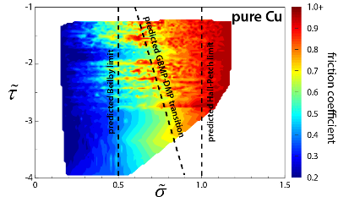
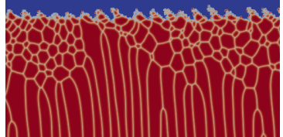
Pre-process In-process Post-process
Process settings
Microscopy & Characterization
Time-series data
Precursor characterization
High-fidelity mod/sim
In-situ characterization
Property/Performance/Aging Measurements
Sifting through a quantity of modalities beyond limits of human cognition
Mix of modalities amenable to first principles modeling

Slide 29

Beyond ”black box ML” for material science
When scientists say AI (as opposed to ML) often they envision modular reasoning and cause/effect
(e.g. Olson Diagram)
Ghosh. Journal of Phase Equilibria. 2002

Slide 30
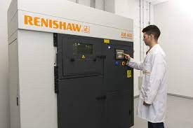
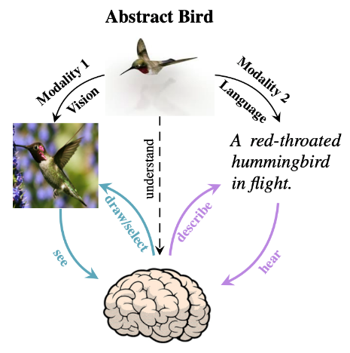










What do we mean by multimodal deep learning?
Traditional Multimodality
Assimilate heterogeneous data sources so they’re greater than sum of their parts
e.g. audio + text to generate
automatic subtitles
High-Fidelity Modalities
Classical material characterization
e.g. microscopy (physical), direct simulation (synthetic)
High-Throughput Modalities Unconventional measurements
e.g. spectroscopy, electrical signals, sound, photographs
AI4SS + AI@DOE workshops denote multimodal scientific data a top opportunity for scientific impact across DOE in next 5-10 years
Shi, Y., Siddharth, N., Paige, B. and Torr, P.H., 2019. Variational mixture-of-experts autoencoders for multi-modal deep generative models. arXiv preprint arXiv:1911.03393.

Slide 31








Beyond Fingerprinting Grand Challenge
PI: Brad Boyce
co-PI: Remi Dingreville
AI team lead: Trask
Process to structure to property
in massive parameter spaces
Multimodal machine learning framework for combining modalities and optimal control
High-throughput fabrication and multimodal testing
z
c

Slide 32






PIMA – physics-informed multimodal autoencoder
Encoder
Decoder
N(μ₁,Σ₁)
N(μ,Σ)
z
Encoder
Physics Model
N(μ₂,Σ₂)
c
Multimodal Data
Modal Fusion
Prediction
Formal Idea
Gaussian product distribution gives deep posterior embedding for each modality
Gaussian mixture prior in latent space identifies populations in data across modalities
Closed form expressions for loss – no Monte Carlo
Supports Bayesian inference across modalities
Informal Idea
We discover a shared latent representation of data providing a Rosetta stone
across modalities
w/ uncertainty
estimation

Slide 33




Physics-based disentanglement of metal additive
For historical lattice compression dataset:
Mode 1: Images of microstructure prior to deformation
Mode 2: Fit piecewise linear expert model to stress/strain response

Slide 34


Physics-based disentanglement of metal AM
Images of lattices and stress/strain curves are disentangled in latent space
Once disentangled, images are calibrated to clusters
Once disentangled, expert models calibrate into two populations
Impact: Low-throughput uniaxial testing replaced w/ high-throughput imaging

Slide 35
Toward causal embeddings
Ex: Correlation vs causation (Schölkopf)
Conditional probability is insufficient to encode causal relationships
Consider the question of city altitude vs temperature
If we can identify causal mechanisms we can identify and exploit precursors to rare events/failure/etc

Slide 36

Combining probability with directed acyclic graphs is necessary to describe causal relationships!
From: Scholkopf, B., Janzing, D., Peters, J., Sgouritsa, E., Zhang, ¨ K., and Mooij, J. M. On causal and anti-causal learning. In Langford, J. and Pineau, J. (eds.), Proceedings of the 29th International Conference on Machine Learning (ICML), pp. 1255–1262, New York, NY, USA, 2012. Omnipress

Slide 37



Causal relationships are encoded via directed acyclic graph to avoid circular reasoning:
But - DAGs are inherently
combinatorial and discrete
Can we use ML to discover DAGs without brute force?
Image credit: Houman Owhadi
($p\left(N\right)=p\left(N_{1}, …, N_{L}\right)=\prod_{ℓ=1}^{L}{p\left(N_{ℓ} | pa_{G}\left(N_{ℓ}\right)\right)}$

Slide 38


Simulated aging of multiphysics systems
Idea
Identify precursors to failure in simulated aging of novel III-V devices

Slide 39
Conclusions and outlook
What will be necessary in next 10 years to develop autonomous systems for scientific discovery?
What theoretical guarantees are necessary to build digital twins for high-consequence engineering systems?
Why SciML?
Develop data-driven models to perform simulations of systems too complex to derive models for
Complex Systems
What guarantees are needed to reliably couple individual models at a system scale
ML for discovery science
Causal models which integrate physics will expose exploitable structure in scientific datasets

